Slide 1
Three moods of language

Slide 2
What’s the difference?
I do well in school.
Do well in school!
Hopefully I do well in school this quarter.

Slide 3
What’s the difference?
Rosa is going to Madrid.
Go to Madrid, Rosa!
I recommend that Rosa go Madrid.

Slide 4
What’s the difference?
We ate the cookies.
Eat the cookies!
The chef suggests that we eat the cookies.

Slide 5
Mood #1: The indicative
The indicative mood is used to make factual statements.
The indicative mood is used to talk about facts in the present (present perfect, present progressive), past, future, and conditional tense.
She does the homework.
She did the homework.
Ella hace la tarea.
Ella hizo la tarea.
She is doing the homework.
She will do homework.
Ella está haciendo la tarea.
Ella hará la tarea.
She has done the homework.
She would do homework.
Ella ha hecho la tarea.
Ella haría la tarea.

Slide 6
Mood #2: The imperative
The imperative mood makes a request or a command.
Carlos, do the homework!
Carlos, ¡haz la tarea!
Don’t do the homework.
No hagas la tarea.
Everyone do the homework, please.
Hagan la tarea, por favor.

Slide 7
Mood #3: The subjunctive
The subjunctive mood is used to expresses a condition which is doubtful or not factual.
It is used to express various states of unreality such as wish, emotion, possibility, judgment, opinion, obligation, or action that have not yet occurred
I recommend that you do the homework!
Yo recomiendo que hagas la tarea.
I hope that the class does the homework!
Yo espero que la clase haga la tarea.

Slide 8
What’s the difference?
I do well in school.
INDICATIVE!
Do well in school!
IMPERATIVE!
Hopefully I do well in school this quarter.
SUBJUNCTIVE!

Slide 9
What’s the difference?
Rosa is going to Madrid.
INDICATIVE!
Go to Madrid, Rosa!
IMPERATIVE!
I recommend that Rosa go Madrid.
SUBJUNCTIVE!

Slide 10
What’s the difference?
We ate the cookies.
INDICATIVE!
Eat the cookies!
IMPERATIVE!
The chef suggests that we eat the cookies.
SUBJUNCTIVE!

Slide 11
Hagan Ahora
In your own words, describe the three moods of language.

Slide 12
If I were a boy
TED Talk

Slide 13
Do you know the subjunctive tense in English?
Take the quiz!
https://goo.gl/forms/ptRmMWG3bVLdUksI2

Slide 14
That’s ok if you don’t!
.....neither does Gwen! (:35)
or Justin! (1:00)
So don't worry!

Slide 15
So why don’t we (as English speakers) know how to use the English subjunctive correctly?
The subjunctive form of a verb often looks identical to the indicative form, and therefore subjunctives are not a very visible grammatical feature of English.
For most verbs, the only distinct subjunctive form is found in the third person singular of the present tense, where the subjunctive lacks the -s ending
She suggests that he speak English
VS.
He speaks English.

Slide 16
How does this compare to the Spanish subjunctive?
The English subjunctive is far less common than in Spanish, and more associated with formal speech and writing.
English has developed certain alternative constructions that allow one to circumvent the use of a designated subjunctive verb form.

Slide 17
Which is written in the subjunctive?
We ask that the match be postponed due to the rain.
Or
We have asked for the match to be postponed due to the rain.

Slide 18
Which is written in the subjunctive?
Honesty is part of our school rules.
Or
Our school rules require that all children be honest.

Slide 19
Which is written in the subjunctive?
It is essential that the game begin at once.
Or
The game needs to start now.

Slide 20
Which is written in the subjunctive?
Please can Matthew come home at lunchtime?
Or
I request that Matthew be allowed to come home.

Slide 21
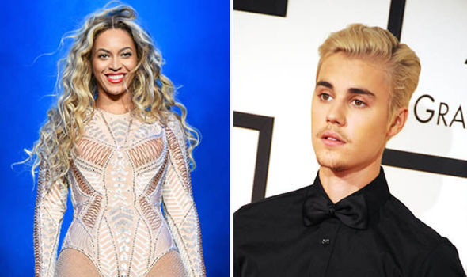
Beyonce VS Bieber

