Slide 1
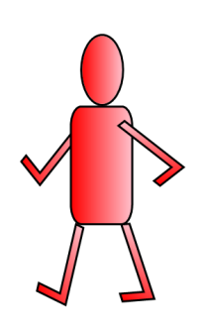
POSSESSIVE PRONOUNS “It is not yours, it is mine!”

Slide 2
What is the difference between a possessive adjective and a possessive pronoun?
A possessive adjective describes who possesses a noun, i.e. it is my pen.
A possessive pronoun replaces the noun and indicates possession of a pre-mentioned noun, i.e. it is mine (the pen I just mentioned).

Slide 3
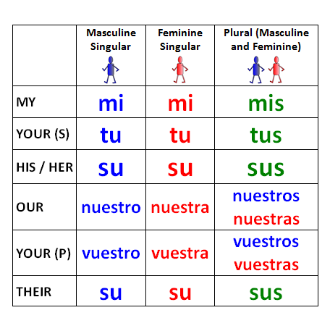
Possessive Adjectives “This is not your pen! It is my pen!”

Slide 4
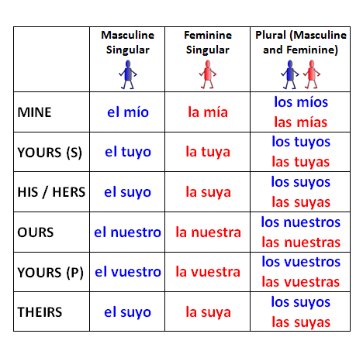
Possessive Pronouns It is not yours! It is mine!

Slide 5
The possessive pronoun must agree in number and gender with the noun it replaces.
Possessive pronouns are accompanied by definite articles.
Mi carro → el mío
Mi casa → la mía
Mis amigos → los míos
Since the form of el suyo can refer to so many people, the meaning of el suyo is not always clear.

Slide 6
Completen.
Mi casa y tu casa → la mía y la tuya
Mi carro y tu carro
Mi maleta y la maleta de Enrique
Tu boleto y mis boletos
Nuestras ideas y tu idea
Mis profesores y los profesores de mi hermano

Slide 7
Establish the gender of the noun and then write the correct possessive pronoun in the blank provided. See if you can translate it as well.
el suyo
El barco es _________. (hers)
Los trenes rápidos son ___________. (ours)
La camisa es _________. (his)
El libro interesante es _________. (yours – S)
Las patatas fritas son ___________. (mine)
los nuestros
el tuyo
las mías

Slide 8
Use the corresponding article (el, la, los or las) with the pronoun except when the verb is a form of ser (soy, eres, es, somos, son) and there is no choice among the possessed objects.
For example...
The book is his. El libro es suyo. (Uses ser, no choice of possessed objects.)
The book is yours or his. El libro es el tuyo o el suyo. (Uses ser, but there is a choice, so it needs the article)
Where are yours? ¿Dónde están los tuyos? (Doesn’t use ser, so it needs the article.)

